Slide 1
Shell Bootcamp 2024 3 Reflections for Week 2
Uditi Gupta
Date : 6-Sept-2024

Slide 2

About Me
You either be as you seem or seem as you are. There is only one life, do your best and stand out. Spread happiness.
Please share an image / visual that best represents you

Slide 3

My learnings from this week!

Slide 4
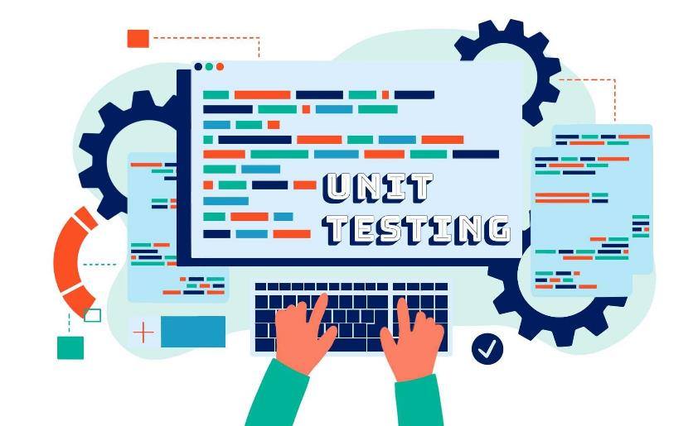
Learning 1 | My takeaways
Things we learn in this weeks Technical bootcamp-
Software testing
Software development life cycle
Software testing life cycle
Functional Requirements
Non-Functional Requirements
Test Driven Development
[Add a graphic that provides evidence of what you learned]

Slide 5
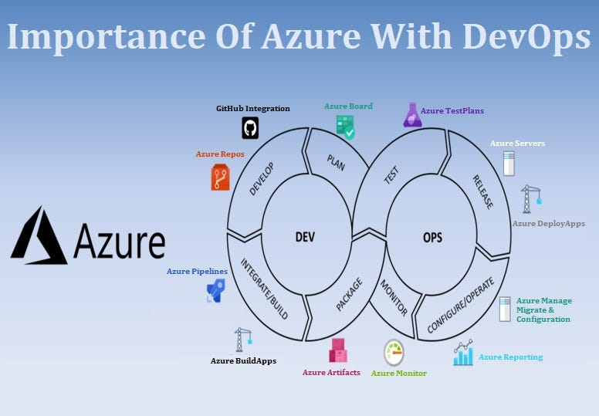
Learning 2 | My takeaways
Things we learned in Day 2 of Technical bootcamp-
DevOps
DevOps Principle
Benefits of Devops
Github Actions
[Add a graphic that provides evidence of what you learned]

Slide 6
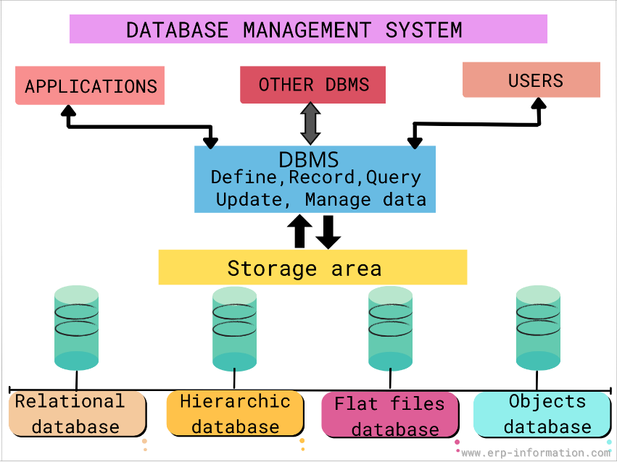
Learning 3 | My takeaways
Things we learnt in Day 3 of technical bootcamp-
Database management system (DBMS)
Relational Database management system
PostgreSQL
YAML file creation for automating the processes
Normalization of data
[Add a graphic that provides evidence of what you learned]

Slide 7

Relevance of learnings for my organization

Slide 8

Learning 1 | Relevance for Shell
Software Testing: Ensures the reliability and security of Shell’s digital systems, crucial for operational integrity.
Software Development Life Cycle (SDLC): Provides a structured approach to software projects, aligning them with Shell’s strategic goals.
Software Testing Life Cycle (STLC): Focuses on maintaining software quality standards, essential for safe and efficient operations.
Functional Requirements: Define the specific functionalities needed to support Shell’s business processes effectively.
Non-Functional Requirements: Ensure software performance, security, and usability, supporting robust and user-friendly systems.
Test Driven Development (TDD): Promotes high-quality software development by ensuring each piece of code is tested as it is written.
[Add a graphic that provides view of how Shell implements this learning]

Slide 9
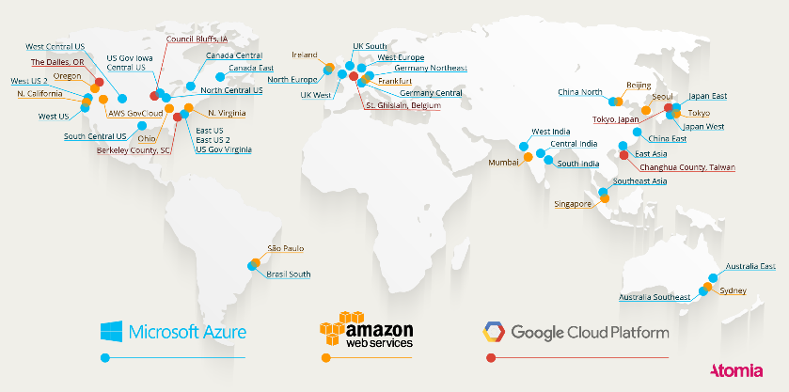
Learning 2 | Relevance for Shell
Software Testing: Ensures the reliability and security of Shell’s digital systems, crucial for operational integrity.
DevOps: Enhances collaboration between development and operations teams, enabling faster and more reliable software delivery.
DevOps Principle: Promotes automation, continuous integration, and a culture of shared responsibility, improving efficiency and quality.
Benefits of DevOps: Improves time-to-resolution, scalability, reliability, and overall team productivity, leading to faster and better product delivery.
GitHub Actions: Automates tasks within the software development lifecycle, streamlining workflows and enhancing collaboration.
[Add a graphic that provides view of how Shell implements this learning]

Slide 10
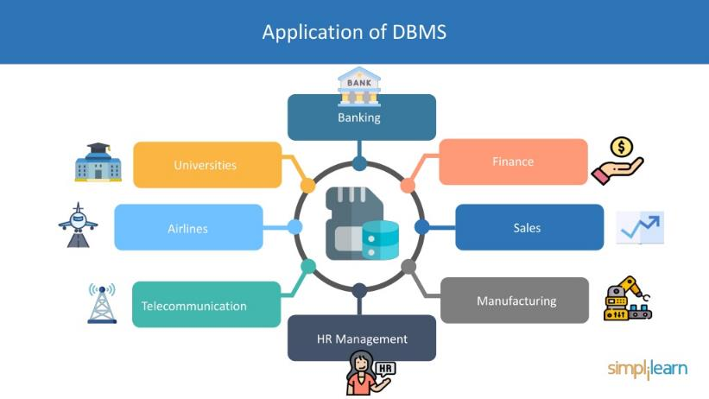
Learning 3 | Relevance for Shell
Database Management System (DBMS): Essential for managing and accessing large volumes of data efficiently.
Relational Database Management System: Crucial for handling complex relationships within industry datasets.
PostgreSQL: Robust, scalable database system for complex queries and data management.
YAML File Creation for Automating Processes: Streamlines repetitive tasks in data workflows.
Normalization of Data: Reduces redundancy and improves data integrity for accurate analysis.
[Add a graphic that provides view of how Shell implements this learning]

Slide 11

Challenges in implementing learning

Slide 12

Challenge faced while implementing Learning 1
Implementing unit testing, TDD, and DevOps practices like CI/CD at Shell involves challenges such as a steep learning curve, resistance to change, and difficulties in writing comprehensive tests. Balancing test writing with functionality and integrating various tools in DevOps can be complex. Overcoming these hurdles requires thorough training, a collaborative culture, and investing in automation tools.

Slide 13

Challenge faced while implementing Learning 2
Implementing Azure cloud at Shell presents several challenges. Migrating existing systems requires significant planning and expertise. Ensuring data security and compliance with regulations is critical, necessitating robust measures and continuous monitoring. The learning curve for Azure’s services is steep, demanding comprehensive training for IT staff. Integrating with on-premises systems and other cloud services can be technically difficult. Managing costs while scaling resources requires careful financial planning. Overcoming these challenges involves strategic planning, training, and leveraging Azure’s support and best practices.
[Add a graphic that provides evidence of what you did to overcome this challenge]

Slide 14
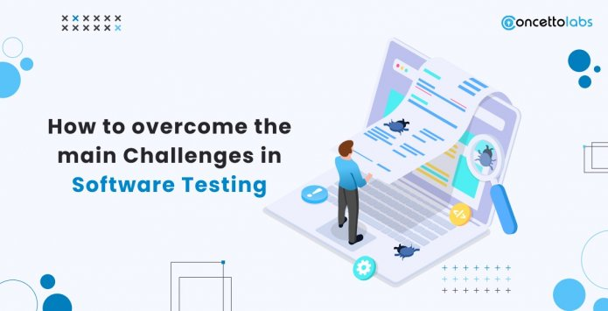
Challenge faced while implementing Learning 3
Implementing a DBMS like PostgreSQL at Shell involves several challenges. Migrating existing data requires meticulous planning and expertise. Ensuring data security and compliance with regulations is critical, necessitating robust measures and continuous monitoring. The learning curve for DBMS features is steep, demanding comprehensive training for IT staff. Integrating the DBMS with on-premises systems and other cloud services can be technically difficult. Managing database performance and scalability as data volumes grow requires ongoing optimization. Overcoming these challenges involves strategic planning, training, and leveraging best practices and support from the DBMS.

Slide 15

Action Plan

Slide 16
My Action Plan for this Week
Actions
Timeline
Status
Practicing skills learnt till date that are Behavioral skills, BA & Agile and DBMS, azure cloud, devops
Saturday – Brush up previous week’s concepts
Sunday – Try out epic-story-feature and SQL queries
Completed

Slide 17

Learning is also Fun!

Slide 18
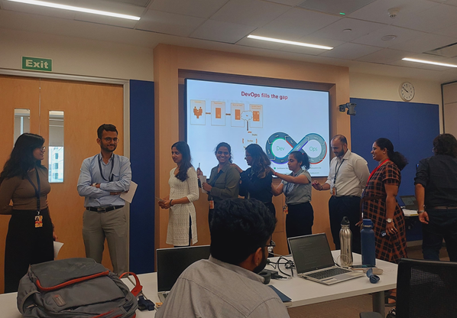
Learning is also Fun!
We played Chinese whisperers to understand that communication is the key to team building.

Slide 19

Summary
Learned topics like software testing TDD, CI & CD, devOps, DBMS
We will begin with department specific training
All the topics are necessary for the company’s work.

Slide 20
Thank You

